Slide 1
Upwind SA Lab
Building, breaking, and defending OWASP Juice Shop on AWS EKS

Slide 2







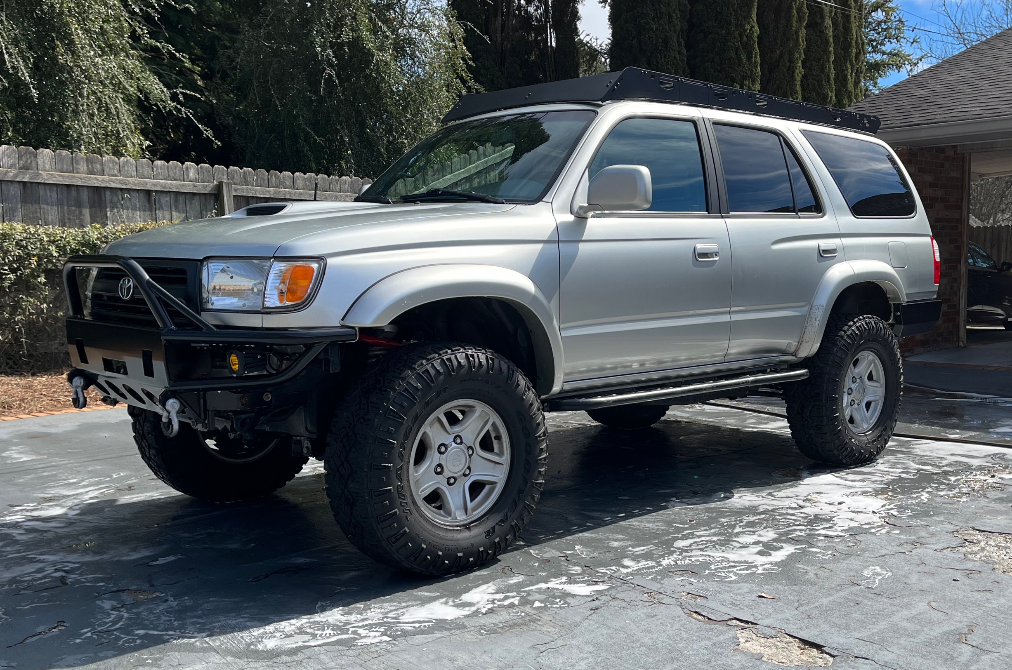
$ whoami
You trust me, right?
David A. Brooks, CISSP, CCSP, AZ104, SCSA, LOREM, IPSUM, OMGWTFBBQ
Pre-sales Security Architect at Vectra AI
Previously Cisco, Lancope, Secureworks
Developed respect for the bad guys
Recovering UNIX admin (dm me your .dotfiles)
Most of career spent in a consultative capacity with enterprise security teams
Atlanta native 👽
One of each: Wife, Daughter, Dog, Cat
Loves old Toyota trucks
Certified cave diver, Meme connoisseur
https://linkedin.com/in/davidanthonybrooks

Slide 3
Overview
Assignment Details
One week to design, deploy, secure, and clearly explain a modern cloud-native environment
Scope: Kubernetes cluster + OWASP Juice Shop + 3 live OWASP Top 10 exploits + defensive hardening
Build Overview
AWS EKS cluster, Gateway API via AWS Load Balancer Controller, Falco runtime detection
Juice Shop deployed from versioned manifests, torn down after every session
This Deck
Architecture & tradeoffs → deployment → live exploitation → incident response → hardening → lessons learned
~30–45 minutes: slides + live demo

Slide 4
Architecture
Topology
AWS EKS 1.36, 2× t3.small managed nodegroup
Entry: Gateway API (AWS LBC) → ALB → juice-shop namespace
security-tooling: Falco DaemonSet, eBPF/kernel-level runtime detection
Rationale
AWS EKS: enterprise-credible, aligns with Upwind’s AWS Security Hub partnership, real IAM/VPC/IRSA talking points
Gateway API via AWS LBC: Kubernetes’ own recommended path for exposing services on EKS
Originally considered ingress-nginx for lab simplicity, but the project has been ended as of March 2026.
Falco: kernel/eBPF-level runtime detection, complementary to app-layer controls
Full manifests, diagrams & scripts: github.com/economycomfort/upwind-sa-lab

Slide 5
Design Tradeoffs
Decision | Choice | Why | Alternative Considered
Juice Shop App Exposure | Gateway API via AWS LBC | ingress-nginx retired Mar 2026, no CVE fixes; Gateway API is K8s' recommended successor | Cilium Gateway API, NGINX Gateway Fabric
Deployment method | Declarative manifests | Repeatable, versioned, a concrete artifact to walk through on screen | Imperative kubectl create/expose
Infrastructure Provisioning | eksctl | Single-command bring-up, no state file to manage for a lab rebuilt each session | Terraform: the more enterprise-preferred IaC method, but eksctl is purpose-built for EKS cluster management
Node Size | t3.small | Right-sized to the workload; fixed-rate costs (control plane, NAT, LB) dominate, not node size | t3.medium likely overkill, and t3.micro would struggle.
NAT Gateway | Single NAT | Halves a fixed idle-cost line; inbound ALB traffic never routes through NAT | HighlyAvailable (per-AZ)

Slide 6





Deployment
1
Provision Cluster
eksctl create cluster (EKS 1.36)
2
Gateway API CRDs
Installed before the controller
3
AWS LBC
Helm + IRSA, wait for rollout
4
Falco
Helm, running before the demos
5
Deploy App
kubectl apply -f manifests/
→
→
→
→
Wrapped end-to-end by scripts/bootstrap.sh and scripts/teardown.sh
Full manifests, diagrams & scripts: github.com/economycomfort/upwind-sa-lab

Slide 7
Exploitation Examples
A01:2025 · Broken Access Control
IDOR
What & Why
App trusts a client-supplied basket ID without verifying the requesting user owns it.
Attacker Gains
Read another user's data: horizontal privilege escalation.
A05:2025 · Injection
SQL Injection
What & Why
Login query concatenates user input directly into SQL instead of using parameterized queries.
Attacker Gains
Full account takeover, no credentials required.
A02:2025 · Security Misconfiguration
Exposed /ftp Directory
What & Why
A directory of files that were never meant to be public is exposed, no crafted payload needed.
Attacker Gains
Information disclosure, a potential further foothold.
Live walkthrough for each: what it is, why it exists, how it's exploited, what an attacker gains
https://owasp.org/Top10/2025/

Slide 8
Exploitation Demo

Slide 9
Hardening & Detection
Vulnerability | Application Fix | K8s / Infra Control | Detection
IDOR | Server-side ownership checks on every object reference | NetworkPolicy limiting lateral movement if the account is compromised | Alert on abnormal sequential ID access patterns in app logs
SQL Injection | Parameterized queries / ORM, input validation | Least-privilege DB service account, secrets not baked into the container image | WAF/API-gateway rule on SQL meta-characters in request bodies
Misconfiguration | Remove debug/verbose error output, restrict exposed paths | Ingress-level path allowlisting, no directory listing | Alert on requests to non-standard paths (404 spikes, /ftp access)
Falco's Boundary
Falco watches kernel/syscall activity. All three exploits here are normal HTTP requests handled entirely inside container app logic with no unusual process, file read, or privilege escalation. Runtime detection is complementary to API-layer controls (WAF, input validation, access checks), not a replacement for them.

Slide 10
Extra Credit: Incident Response
If the SQLi login bypass were discovered in production (mapped roughly to the SANS incident response framework):
1
Detect
App-layer event; Falco can't see it. Needs a WAF rule or log monitoring.
2
Triage
Confirm scope: token role, what the session touched, is it still active?
3
Contain
Rotate credentials, block the route, isolate via NetworkPolicy.
4
Recover
Ship parameterized queries, verify the fix, restore traffic.
5
Learn
Add a CI regression test, make the detection permanent, write it up.
→
→
→
→
Source: https://www.sans.org/security-resources/glossary-of-terms/incident-response

Slide 11
Lessons Learned
1. Verify tooling is still current before building on it
The lab was originally built on ingress-nginx, which I realized mid-lab had been officially retired months prior (😬). Re-architected onto Gateway API via AWS LBC rather than ship something already deprecated, even though it was working fine.
While very minor, I originally did not provide a cluster version to eksctl, which resulted in 1.34 clusters that were also very near end-of-support.
2. Controller feature flags can be silently disabled at startup, with no error
AWS LBC checks for the Gateway API CRDs once, at its own startup. Installing the controller before the CRDs left Gateway API support quietly off, no error, only a restart after the CRDs existed fixed it. Order: CRDs before controller.
3. "Helm deployed" isn't the same as "pod ready"
AWS LBC's admission webhook registers as soon as Helm's install is accepted, before the controller pod is actually running. Applying manifests immediately after hit a no endpoints available error. Fixed with an explicit rollout status wait.
4. Declarative doesn't mean order-independent
kubectl apply -f manifests/ applies files alphabetically, not by dependency. A Deployment referencing a not-yet-created namespace failed on the first full apply. Fixed with numeric filename prefixes.
5. Don’t assume AI proficiency
Not everything needs a GPU. A workflow or process speedbump presents an opportunity to a novice to iterate or an expert to make an informed decision based on experience. One of those is both quicker and more accurate, not to mention more carbon-neutral. Sonnet 5’s understanding of k8s-related CLI tooling is fine to scaffold with, but not to rely on.

Slide 12
Thank You!

Slide 13
Appendix

Slide 14
Lab Resources
Lab Assets: https://github.com/economycomfort/upwind-sa-lab
Exploit and lab recordings: https://drive.google.com/drive/folders/1dxv0Gircm8qBIaSG3OWoAefVsSxF1Y1N?usp=sharing

